Slide 1



Blinkit
India's Last Minute App
Presented by-
Prathamesh Mohol

Slide 2
Introduction
This project presents a comprehensive Sales Analysis Dashboard for Blinkit, developed using Power BI.
The objective of this analysis is to gain deeper insights into sales performance, revenue trends, product categories, and regional contributions.
The dashboard enables data-driven decision-making by providing interactive visualizations and key performance indicators (KPIs).
It helps management identify top-performing products, monitor sales growth patterns, and uncover areas requiring improvement.
The insights derived from this report aim to support strategic planning and enhance operational efficiency.

Slide 3
Problem Statement
Objective
To perform a comprehensive analysis of Blinkit’s sales performance using Power BI.
To identify key revenue drivers, top-selling products, and high-performing regions.
To track sales trends over time and monitor growth patterns.
To provide interactive dashboards that support real-time insights and decision-making.
To enable management to make data-backed strategic and operational decisions.
Blinkit’s sales data is spread across multiple sources, making it difficult to obtain a unified view of performance.
Management lacks a centralized reporting system to track revenue, product performance, and customer demand effectively.
Manual reporting leads to delays in identifying trends and issues, impacting timely decisions.
There is a need for an automated, visual, and interactive sales analysis solution that enhances business intelligence and improves strategic planning.

Slide 4
Key Findings
Overall Sales Performance:
The total sales showed a consistent upward trend over the analyzed period, with a notable 15–20% increase in the last quarter.
Top-Performing Categories:
The “Fruits & Vegetables” and “Snack Foods” categories contributed the highest revenue share, accounting for over 40% of total sales.
Product Performance:
Fast-moving consumables like snacks highest order frequency, indicating strong customer preference and repeat buying patterns.
Outlet Performance:
The outlet established in 2018 recorded the highest number of sales compared to all other outlets, indicating strong brand presence and customer loyalty at this location.

Slide 5
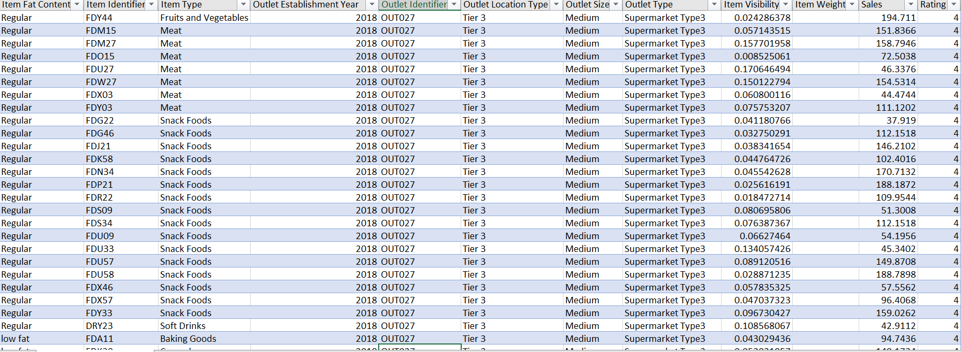
Dataset

Slide 6
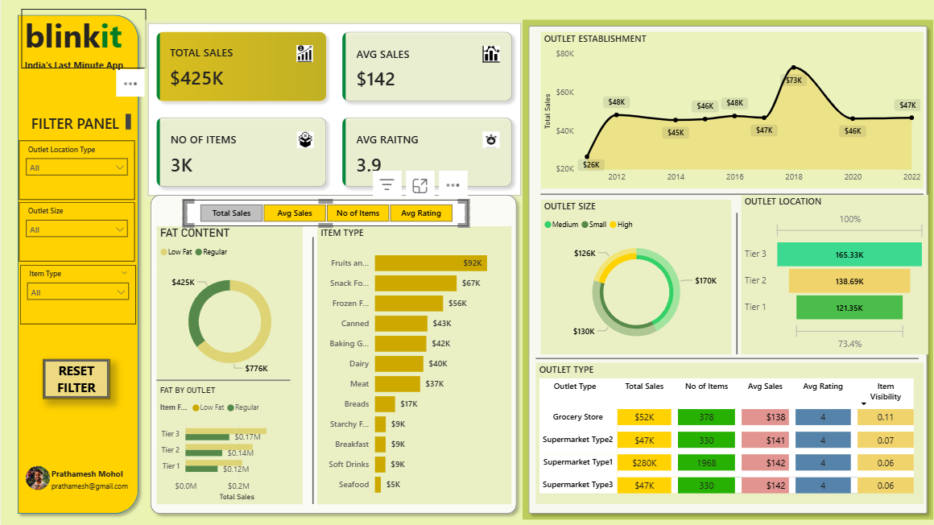
Dashboard

Slide 7
Conclusion
The Power BI sales dashboard provided a comprehensive view of Blinkit’s sales performance, highlighting key trends across outlets, products, and regions.
The 2018-established outlet emerged as the top performer, reflecting strong operational efficiency and customer engagement.
Sales are driven primarily by Fruits & Vegetables and Snacks, with consistent growth in metro regions.

Slide 8
Thank You!

